Slide 1
Histogram Matching or Specification
Prof Suresh Pabboju

Slide 2
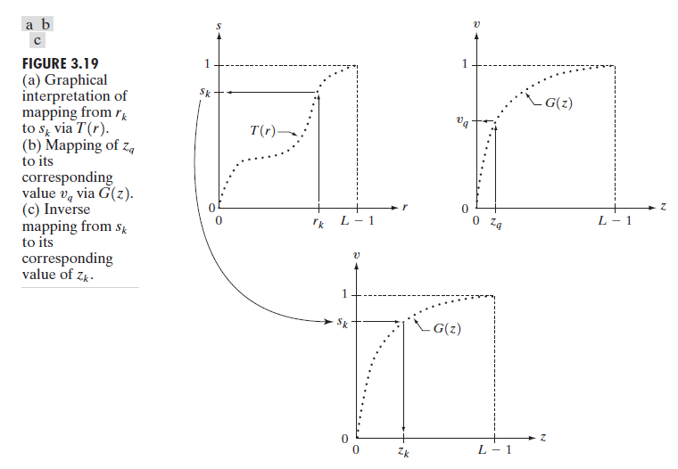
Histogram Matching or Specification

Slide 3
The procedure for histogram matching
1. Obtain the histogram of the given image.
2. Use Eq. (3.3-13) to pre-compute a mapped level s_{k} for each level r_{k}
3. Obtain the transformation function G from the given p_{z}(z) using
Eq. (3.3-14).
4. Pre-compute z_{k} for each value of s_{k} using the iterative scheme defined in connection with Eq. (3.3-17).
5. For each pixel in the original image, if the value of that pixel is r_{k}, map this value to its corresponding level s_{k}; then map level s_{k} into the final level z_{k}.
Use the pre-computed values from Steps (2) and (4) for these mappings.

Slide 4
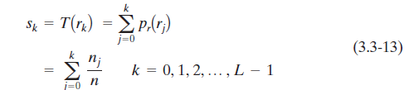

Histogram Matching or Specification..

Slide 5
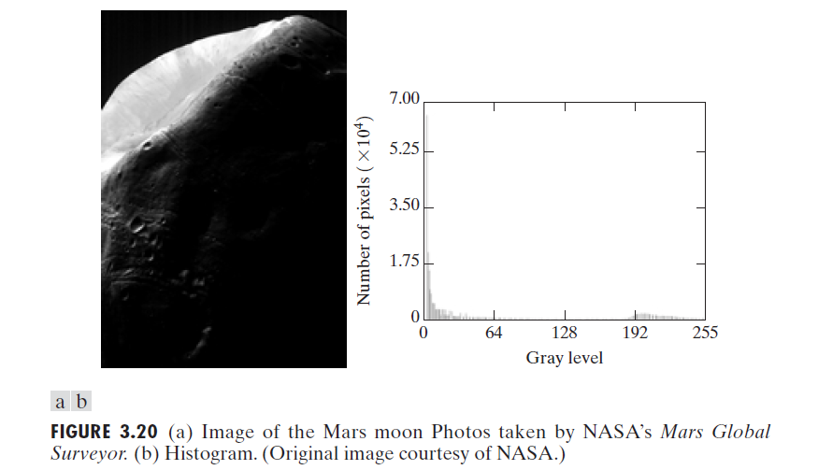
Histogram Matching or Specification..

Slide 6
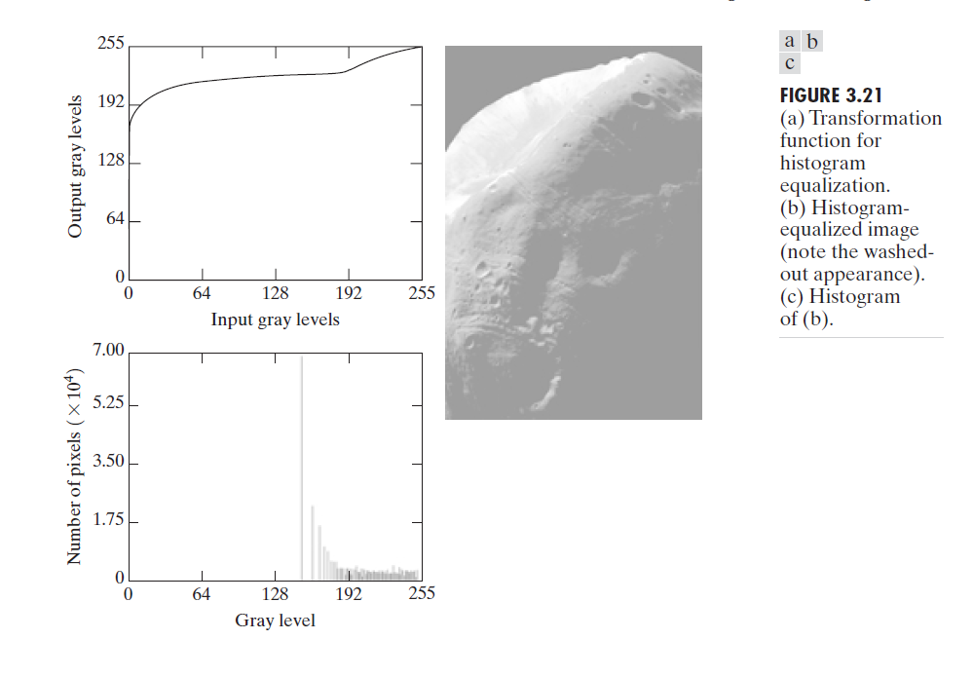
Histogram Matching or Specification..

Slide 7
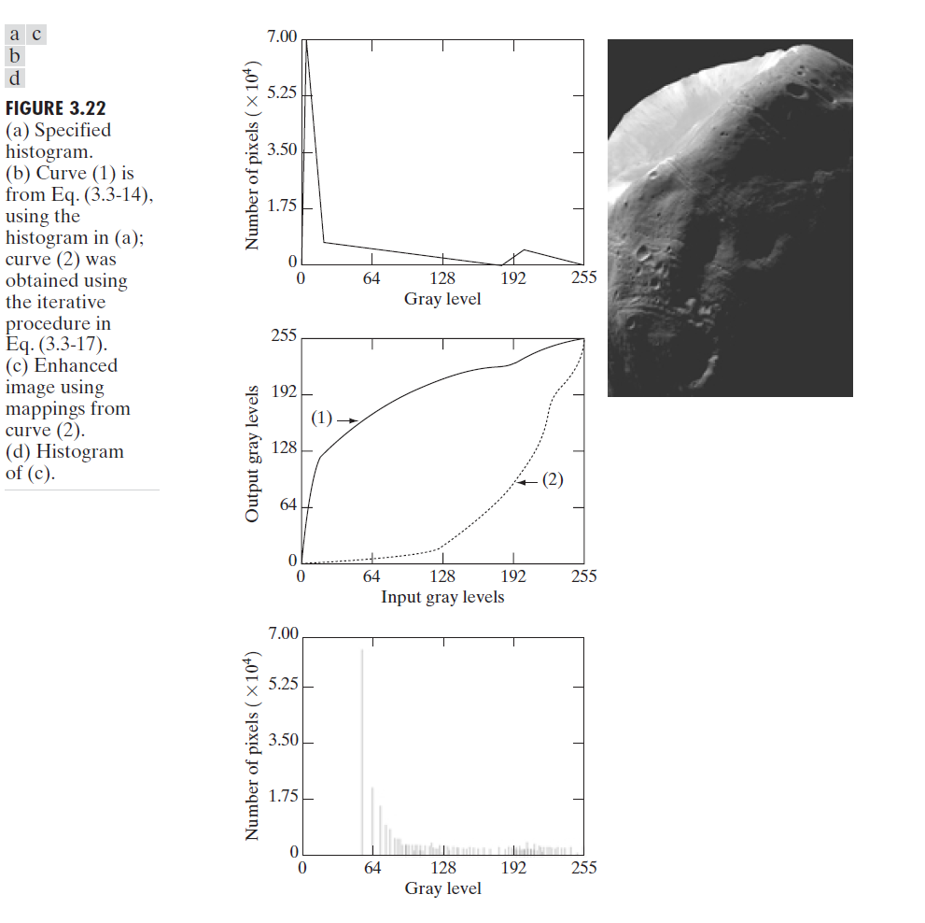
Histogram Matching or Specification..

